Slide 1
Public Cloud 202: Azure VWAN Internet Inbound
John McDonough / Srija Reddy Allam / Robert Reris / Jeff Kopko Fortinet Cloud CSE

Slide 2
Azure Virtual WAN
Azure Networking and Routing

Slide 3



Azure Routing
Other than Default Routing
User Defined
Azure Route Server
Azure Virtual WAN

Slide 4
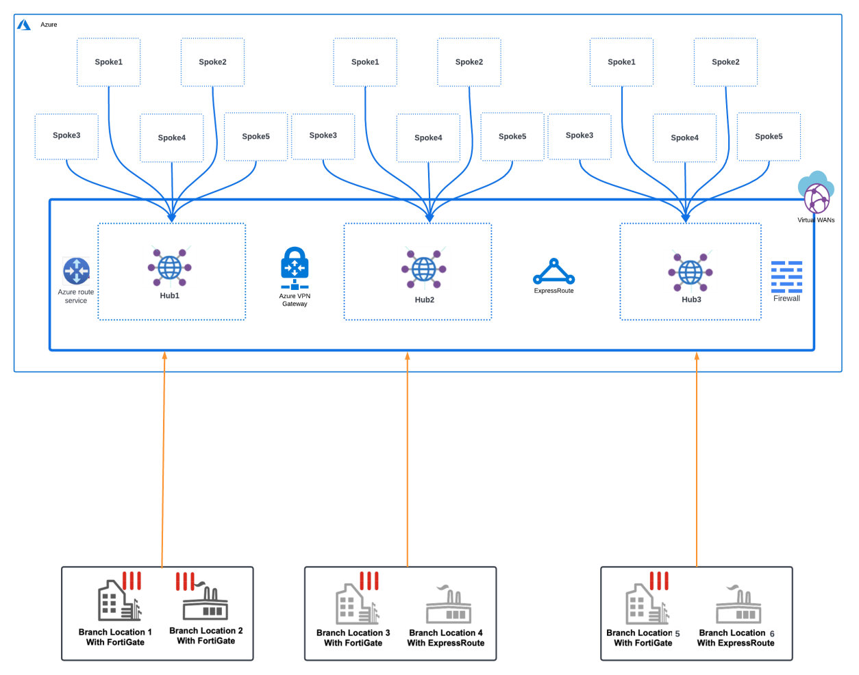
What is Azure Virtual WAN
Simplifies management hub and spoke deployments
Large-scale branch connectivity with VPN and Express Route
Unified network and policy management
Optimized routing with Microsoft global network
Advanced Routing – BGP and Routing Intent
Integrates with Fortinet FortiGate solutions providing SD-WAN and NGFW services

Slide 5
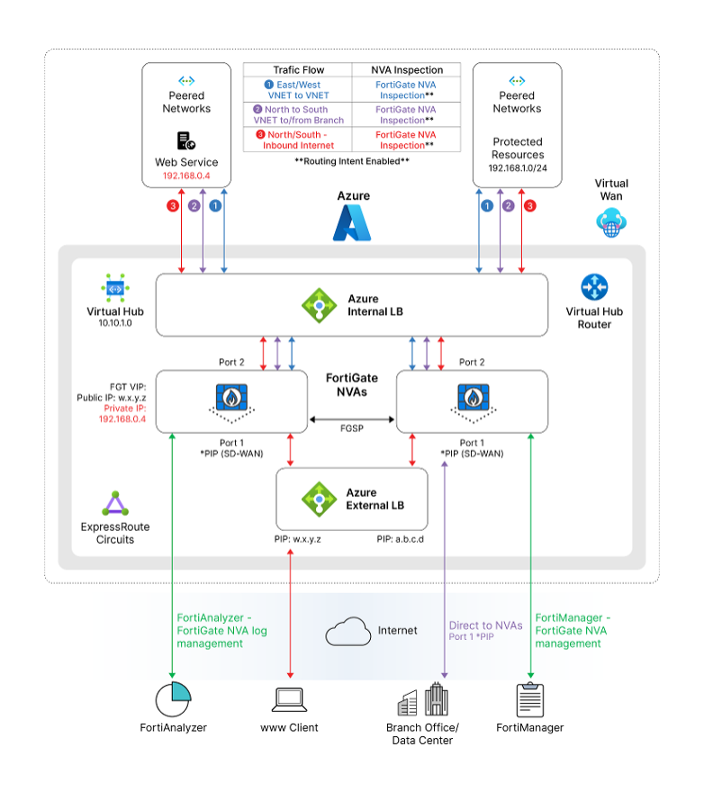
FortiGate Integration with Azure VWAN
The industry’s first fully Integrated network virtual appliance providing Secure SDWAN AND Next Generation Firewall Services
Simple and structured deployment model
Deployed via Azure portal – Managed service
SDWAN and/or NGFW deployment options
High Availability and Resiliency
Active-Active – up to 5 FortiGates (NGFW)
Performance and Scale
Dynamic Routing Capabilities
Single management interface – FortiManager – Appliance / VM
Centralized logging – FortiAnalyzer – Appliance / VM
Flexible licensing options
BYOL / FortiFlex
PAYG – New in Q2 2024

Slide 6
Azure Marketplace Plan
NGFW
SD-WAN & NGFW

Slide 7
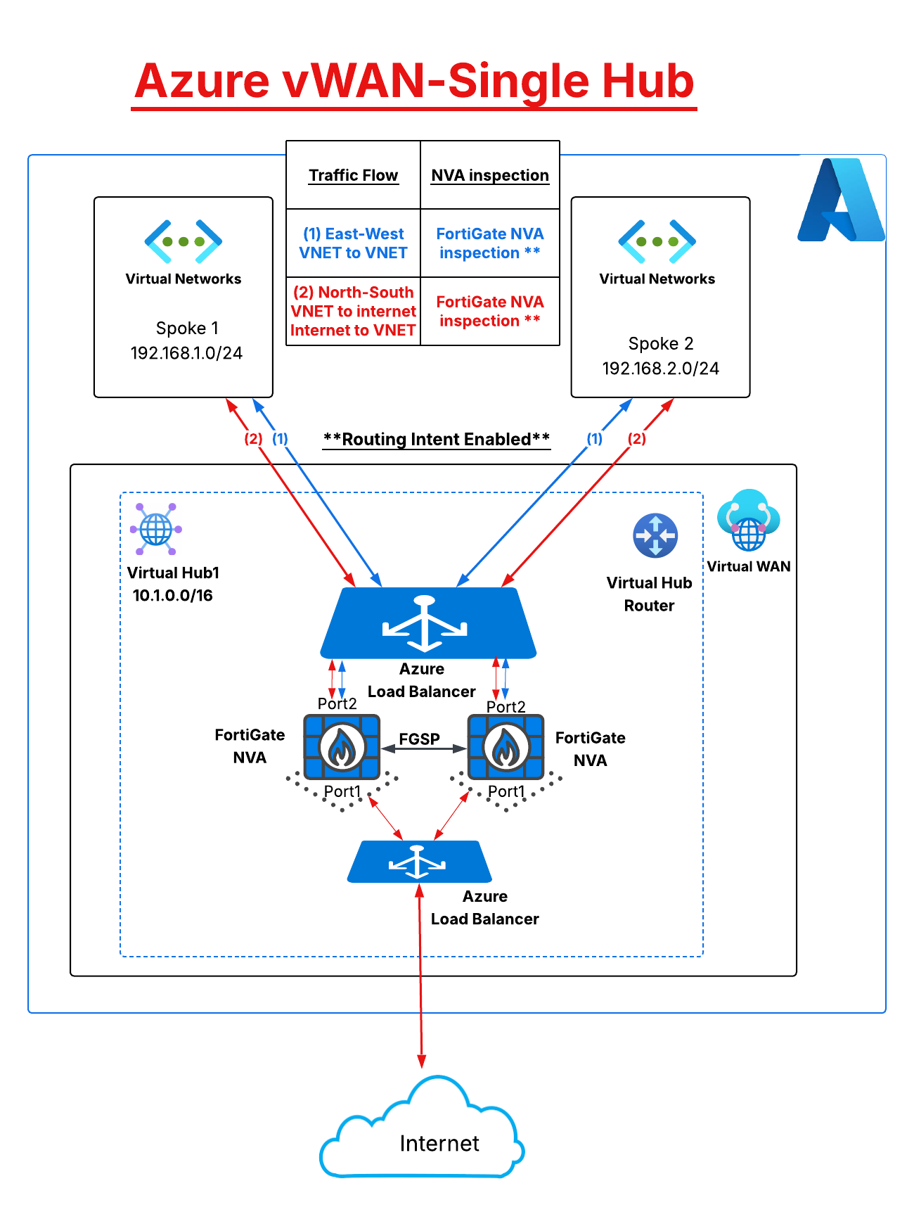
NGFW Only - Option
Inspects East-West and Internet bound traffic
Network inspection across VNETs connected to the
Virtual WAN
Internet bound traffic inspection
High Availability and resiliency
Active-Active - supports up to 5 VMs and 40 Gbps
Performance and Scale
Dynamic Routing Capabilities
Single management interface – FortiManager – Appliance / VM
Centralized logging – FortiAnalyzer – Appliance / VM
Flexible licensing options
BYOL / FortiFlex
PAYG

Slide 8
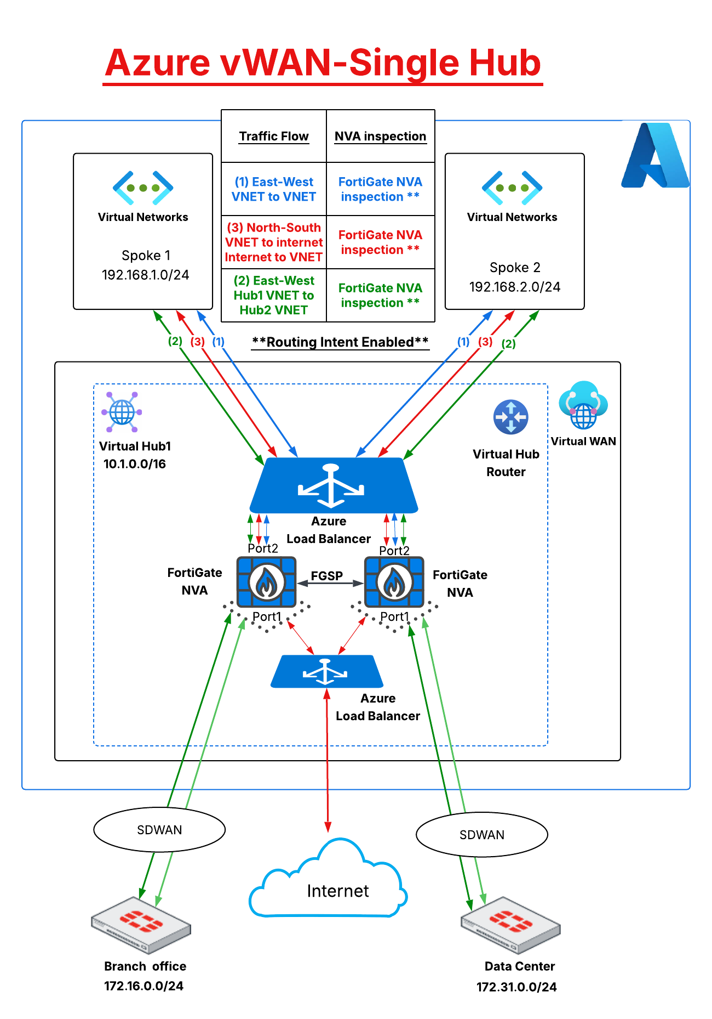
SDWAN & NGFW - Option
North-South inspection for traffic destined to the Internet or the SDWAN connected networks. (See red & green traffic flows on the diagram)
Inspection across vNETs connected to the virtual WAN (See blue traffic flow on the diagram)
High Availability and resiliency
Active-Active – supports 2 VMs up to 10Gbps
Performance and Scale
Dynamic Routing Capabilities
Single management interface – FortiManager – Appliance / VM
Centralized logging – FortiAnalyzer – Appliance / VM
Flexible licensing options
BYOL / FortiFlex
PAYG

Slide 9
Order Types in VWAN

Slide 10
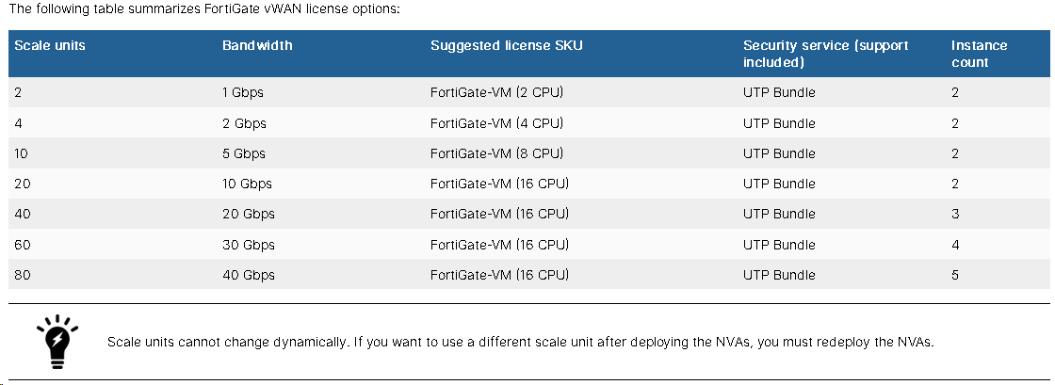
NGFW Only – Scale Units

Slide 11
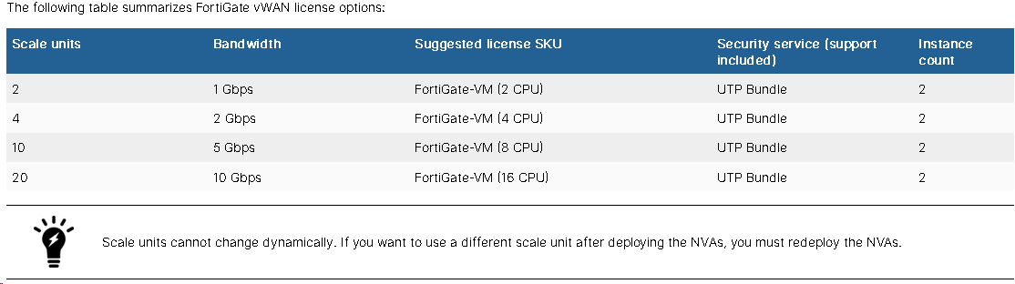
SDWAN & NGFW – Scale Units

Slide 12
Lab Overview

Slide 13

5x columns
Paragraph Text
Overview
Deploy
Configure
Route
Verify
Connect to Azure Environment
Review Resources
Deploy FortiGate NVAs in Azure VWAN Hub
Deploy 2nd vWAN Hub
Deploy Linux VMs
Configure FortiGates
Configure FGSP
Firewall Policies
Configure VNET peering
Configure FortiGate Static Routes
Ensure BGP peering
Configure Azure Routing Intent
Configure Internet Ingress
Verify Spoke to Spoke
Verify Spoke to Internet
Verify Internet to Spoke
Verify Hub to Hub

Slide 14
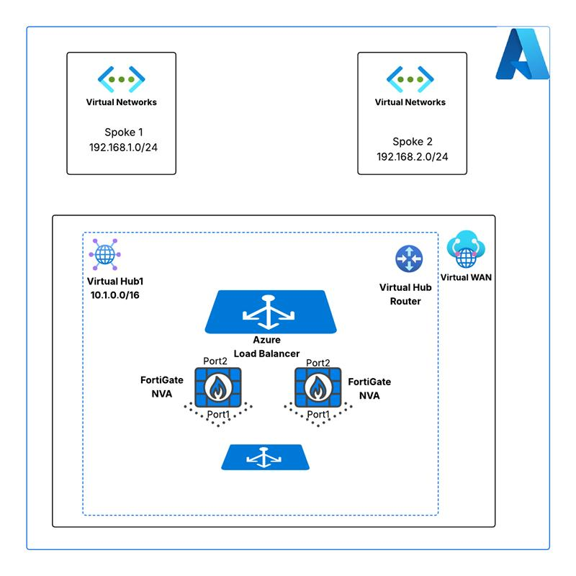
Virtual WAN Components – Virtual WAN
Managed Service deployed from Azure portal
Simple deployment template
Name
Region
Resource Group
Type (connectivity options)
Standard
Basic
**Already deployed

Slide 15
Virtual WAN Components – Virtual Hub
Managed Service deployed from Azure portal
Simple deployment template
Name
Region
Resource Group
Address space
Capacity (Scale Units)
Routing Preference
AS Path
Express Route
VPN
Additional Services
**Already deployed

Slide 16
Virtual WAN Components – Virtual Networks
VNETS deployed from Azure portal
Comprehensive deployment template
Name
Region
Resource Group
Address space
Subnets
Additional Services
Virtual Machines
**Already deployed

Slide 17
Virtual WAN Components – FortiGate NVA
FortiGate NVAs deployed from Azure portal - VWAN Hub page
Simple deployment template
Name
Region
Resource Group
Address space
Subnets
Additional Services
Ingress Public IP
Ingress External Load Balancer
Virtual Machines
**Attendee will deploy

Slide 18
Questions

Slide 19
Getting Started
Moderated by instructors
Username assignments
https://fortinetcloudcse.github.io/azure-202-advanced
Review lab material

